Slide 1


November 2019
Infrastructure Testing With PowerShell & Pester

Slide 2

Who is this guy?
Bill Kindle – Systems Administrator
Contributor to The PowerShell Conference Book vol. 2
Guest Writer for AdamTheAutomator.com and Content Contributor at TechSnips.io
Is really into model railroading and trains
Father of two wonderful, sticky, little people who don’t pay rent.
Husband to a loving wife whom he’d be absolutely lost without.

Slide 3
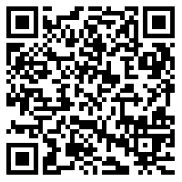
If you want to follow along, the code examples are available here:
SCAN ME!
git clone https://github.com/billkindle/FWVMUG_November_2019_Testing_Infrastructure_With_Pester.git

Slide 4

Story Time!

Slide 5
Pester
A Dual-Purpose PowerShell Module for the Developer and SysAdmin

Slide 6
What is Pester
?
?
?
Pester is a testing framework for PowerShell code.
It’s a DSL (Domain Specific Language) with an easy to understand syntax
Comes built-in with Windows 10, Server 2016 and 2019
Works with CI/CD pipelines (Jenkins for example)
It isn’t just for testing PowerShell code, it can also be used for…
?
?

Slide 7

Let’s Talk About Testing Infrastructure

Slide 8



Why Testing is Important
Human Error
Money / Time
Right Thing To Do

Slide 9

Let’s turn our checklists…
…into TaC (testing-as-code).

Slide 10
Pester Testing Quick Start
What you need to know Right now

Slide 11

How to Get This Module
PS> Install-Module -Name ‘Pester’
PS> Save-Module -Name ‘Pester’ -Path ‘.\’
PS> Update-Module -Name ‘Pester’

Slide 12
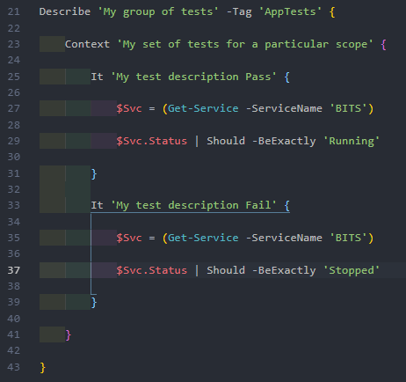
Basic Syntax & Structure
Describe Block
Context Block
Assertion Block
Assertion Block

Slide 13
Asserting The Expected State
What’s Expected= [+] /Green / Pass / Good
Not What’s Expected = [-] / Red / Fail / Bad

Slide 14


Red-Gate.com Article on Pester

Slide 15

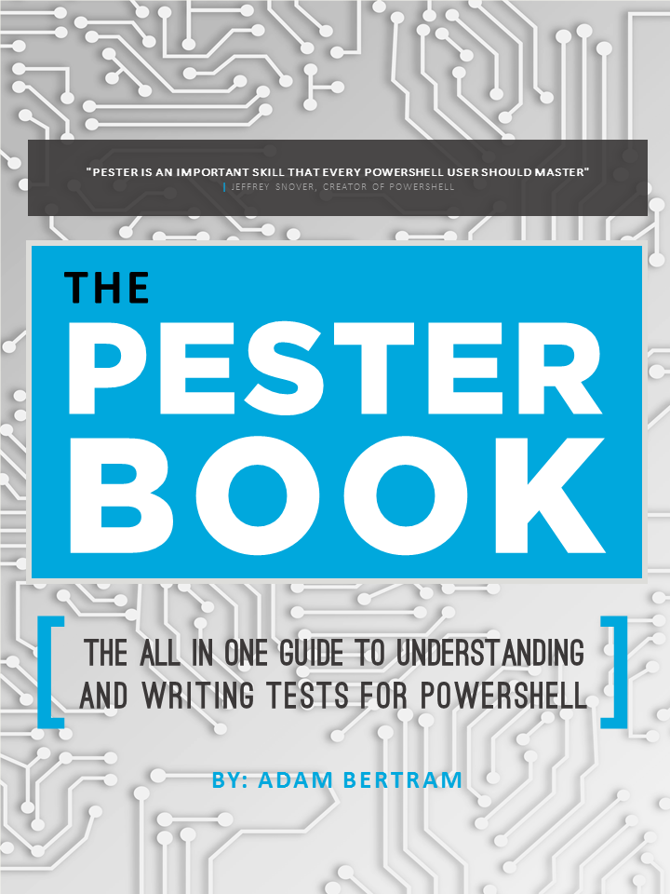

https://leanpub.com/pesterbook
SCAN ME!

Slide 16


SCAN ME!
https://github.com/vexx32/PSKoans

Slide 17

Support the Developers of Pester
https://opencollective.com/pester
SCAN ME!

Slide 18

Thank You!

